Slide 1
Self
CLASS XII
CHAPTER TWO
AKANKSHA MALHOTRA

Slide 2
SELF
SELF
CONCEPT
SELF
ESTEEM
SOCIAL
SELF
SELF AWARE

Slide 3
SELF
A newly born child does not have any idea about self . As one grows older the idea of self emerges.
OUR INTERACTION WITH OTHER PEOPLE ,OUR EXPERIENCES AND THE MEANING WE GIVE TO THEM SERVE AS THE BASIS OF OUR SELF .

Slide 4
CHILD’S SELF
TEACHERS
FRIENDS
PARENTS
SIGNIFICANT
PEOPLE

Slide 5
KINDS OF SELF
SOCIAL SELF PERSONAL SELF
In relation with others Primarily concerned
Such as cooperation, with oneself.
Unity, affiliation, personal freedom,
Sacrifice ,Support responsibility, comforts,
or sharing achievements

Slide 6
SELF CONCEPT
THE IDEA THAT WE HOLD ABOUT OURSELVES, OUR ATTRIBUTES AND COMPETENCIES.
IT CAN BE NEGATIVE OR POSITIVE
SIMPLE METHOD TO FIND OUT SELF CONCEPT OF AN INDIVIDUAL IS BY ASKING THE PERSON ABOUT HIMSELF AND HERSELF.

Slide 7
Self concept
Other’s
images
Your interpretations and evaluation
Cultural teachings
Social comparison

Slide 8
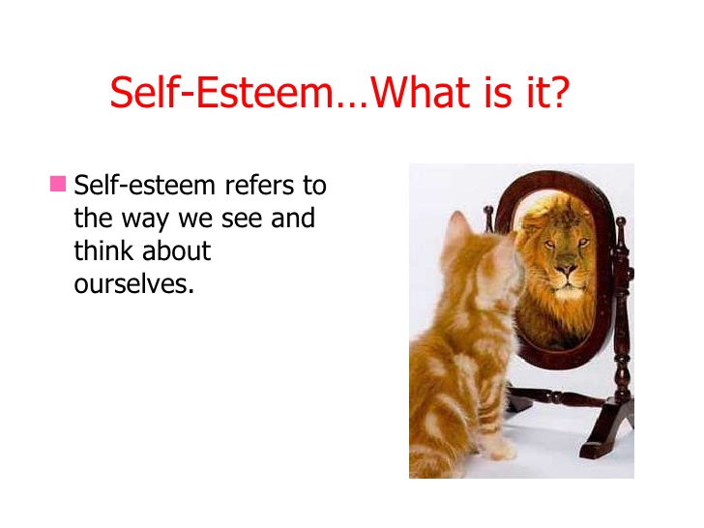

Slide 9
SELF ESTEEM (value judgement)
Some can have high self esteem and others can have low self esteem which is based on our experiences and opinion based on others.
Children of 6-7years of age formulate their self esteem at least in three areas-
Academics Physical appearance
Social
Strong relation between self esteem and behaviour.
Self esteem is influenced by warmth and positive parenting and culture (collectivism and individualism)

Slide 10
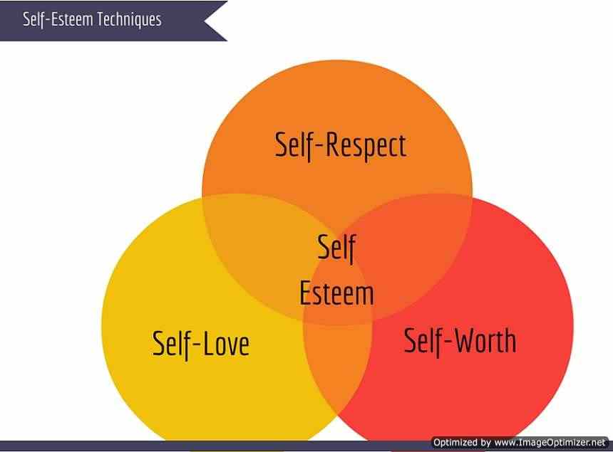

Slide 11
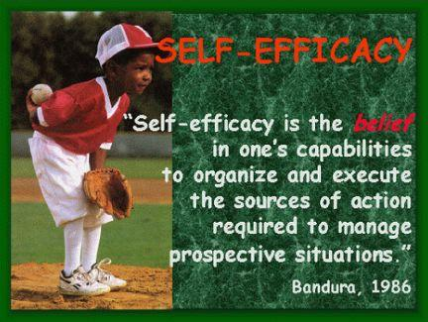

Slide 12
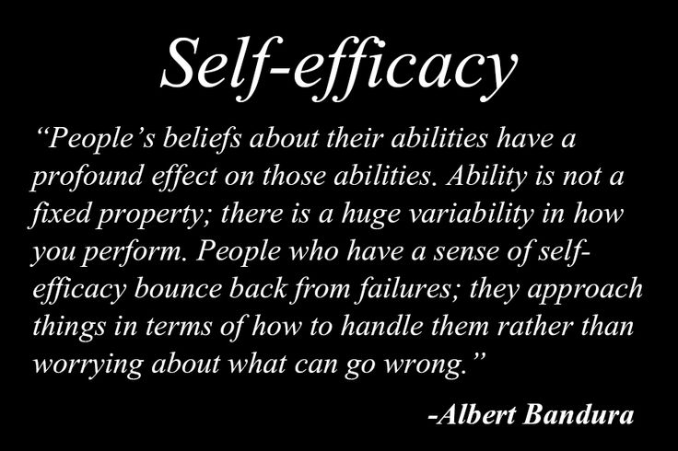

Slide 13
It is based on-
BANDURA ‘S SOCIAL LEARNING THEORY.
People with strong self efficacy are less fearful.
It can be developed at any time. Our society, parents and our positive experiences are the factors which formulate self efficacy.
Concept of collective self efficacy (like minded people)
Overcoming phobias.

Slide 14
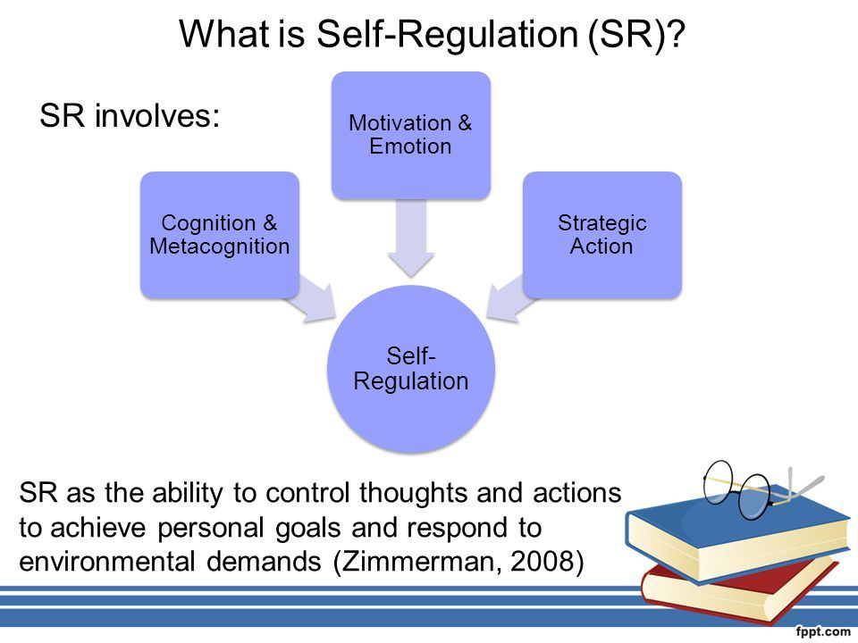

Slide 15
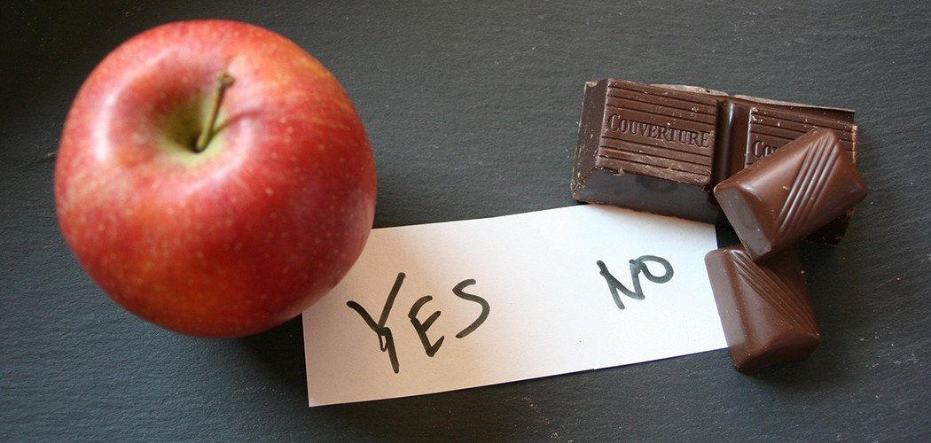

Slide 16
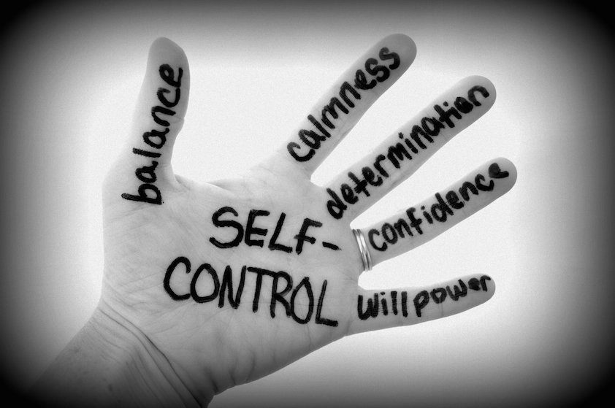

Slide 17
SELF CONTROL
LEARNING TO DELAY OR DEFER GRATIFICATION OF NEEDS.
IT IS IMPORTANT FOR ACHIEVING LONG TERM GOAL.
IT CAN BE GENITICALLY DEVELOPED.
TECHNIQUES OF SELF CONTROL-
i) observation of own behaviour
ii) Self instruction
iii) Self reinforcement

Slide 18
CULTURE AND SELF
CULTURE HAS VERY INFLUENTIAL ROLE TO PLAY IN SELF.
CULTURE
INDIAN WESTERN
Individual Group
Group Individual

Slide 19
THANK YOU……..

